Slide 1

Real Time Engineering
Slab & Coil Yard Management and Plate Stock Report , Planning, Production, Reporting & Data Base Management Solution for Metal Industry
Embedded with Technology
Innovative Technology
Customized & Tailored Made Solutions
Committed to Best Customer Service
Proven & Reliable Design & Engineering

Slide 2


Enterprise Resource Planning
(Information to Top Management)
ERP / SAP/ MES
Oracle Database
SQL
High-end control systems
Independent
Innovative technology
Complete Systems
VERTICAL MARKET
SOLUTIONS
(MES)
Automation
(Level-1 & 2)
Siemens
ABB
Schneider-Electric
Rockwell Automation
Honeywell
SOLUTION OF COMPLEXITY

Slide 3
We are a Solution Provider........
“ROI” is our satisfaction
We value the demands of our Customer’s Benefit & Investment from our combined competence with these THREE key capabilities.
Customized
& Tailored
Made
Products
Embedded
with
Technology
Integration with
Level-1 & Level-2
System

Slide 4
What we do?
Production Management
Material Stock Data Base Management
Material Grade Performance Report
Product Test Report
Integration with existing ERP / SAP / MES

Slide 5


Production Management
Production
Procurement
Sales
Supply Chain Planning
Production
Management
MIS
MES
Supply Chain Execution

Slide 6




Supply Chain Management
Order Processing
Sales Order
Received
Sales Order
Entry
Production
Validation
Production
Costing
Production
Order to Plant
Scheduling
Production Planning
Order Scheduling &
Material Allocation
Master
Planning
Capacity &
Campaign
Management
Caster &
Melt Shop
Scheduling
Plate & Steckel
Mill
Scheduling
Plate & Coil
Finishing
Scheduling
Raw Material
Planning
Plate & Coil
Combination
Production Execution & Material Logistic
Production
Order
Life Cycle
Material &
Stock
Management
Schedule
Execution
Management
Production
Tracking
Quality Control
& Deviation
Management
Warehouse &
Transport
Management

Slide 7

Sales Orders / Production Orders
Customized MES-MIS
Performance
Monitoring to
Management
Demand and Sales Planning
Due Date Quoting
Consistent Plan
Status
Master and Capacity Planning
Order Scheduling
Material Planning
Production Line Scheduling
Real time
Production Status
Manufacturing Execution (Production)

Slide 8
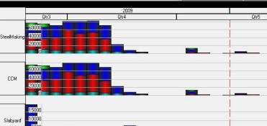
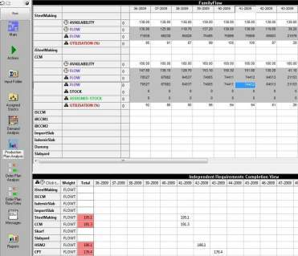
Demand & Sales Planning
Balanced demand forecasts based on
  Historical sales data
  Market data
Allocation of demand to sites
Sales plan based on
  Available capacity
  Demand forecast and
  Current production plan
Considering:
  Multiple sites with alternative production routes
  Product cost and profit model
  Available capacity constraints
  Target inventory levels and inventory constraints
Interactive or automated Due Date Quoting

Slide 9
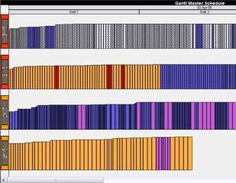
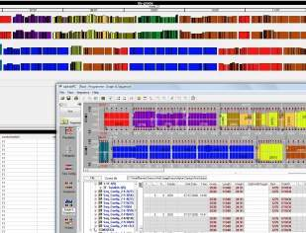
Capacity & Master Planning
Calculation of capacity plan and
target flow on product family level
Alignment with sales plan
Material flow plan based on
  Daily productivity per product family for each line
  campaign description of every line
  inventory constraints
  Current WIP (order backlog/advance) based on results of order scheduling
Reactive adjustments to the contingents
Target flows for short term planning horizon (order and line scheduling)
Simulation and “What-if-Scenario”
Manual Re-adjustments

Slide 10
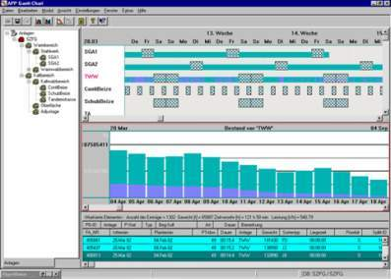
Order Scheduling
Cross-plant scheduling of the order book
Forecasting of expected delivery dates
Streamlining of the physical material flow across the plants considering
  Product mix constraints from master planning
  Campaigns and capacity plan from master planning
  Inventory constraints
  Order Prioritization
  Existing line schedules
Integrated Material Planning
  Automated or interactive Inventory allocation
  Nested plate/coil optimization
Dynamic rebalancing of campaign sizes according to physical material flow
Bottleneck optimization

Slide 11


Material Planning: Net Demand Calculation
Net demand
for caster
Net demand
for hot strip
Net demand
for cold strip
Inventory
check
Yield
Loss
Inventory
check
Yield
Loss
Inventory
check
Yield
Loss
Gross demand
for slabs
Gross demand
for Hot Strip
Gross demand
for Cold Strip
Slab Yard stock
Hot strip stock
Cold strip stock
Checking of available inventory (automatically or by manual interaction)
Customizable, individual matching of order and material based on attributes level for each production step
Calculation of remaining net demand backward
Aggregation of small order quantities (e. g. for heat completion)

Slide 12
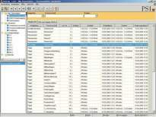
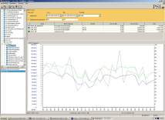
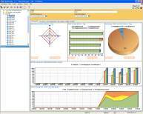
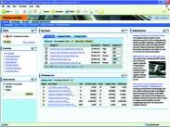

Technical Data Warehouse
Reports Quality Analysis Historians Management
Information
My SQL / Oracle Data Base
Operational
Database Entry:
Auto / Manual
Technical
Data Warehouse

Slide 13
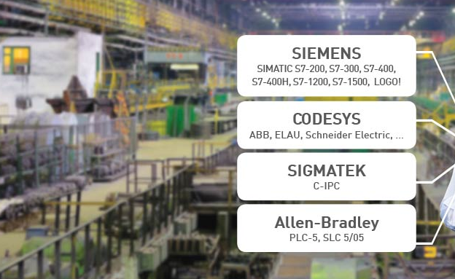

Integration with IBA System through Fast Data Network
Acquire Data from Any Source of Controller or PLC
Record Data On-Line in the Data Base
Analyze Data for “Fault or Event Log”
Derive information and Generate Tailored made Report

Slide 14

1D, 2D & QR Code and Bar Code Reader
We have solution for barcode scanners that read 1D, 2D, and QR codes, and barcode readers that are compatible with iPhone, iPad, and Android devices.
Coil or Slab ID (Chemistry / information) will be integrated to MES or SAP System
Slab or Coil Yard Data Base Management

Slide 15
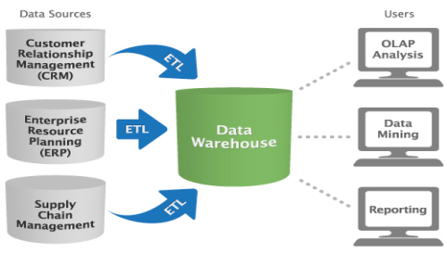
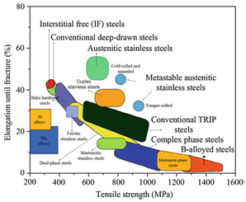

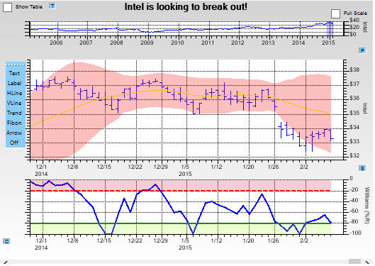
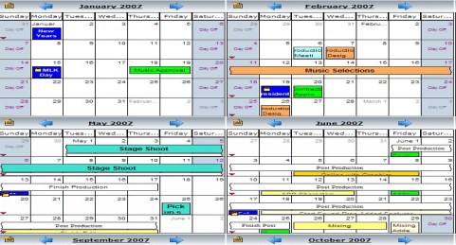
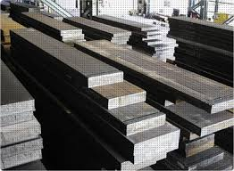
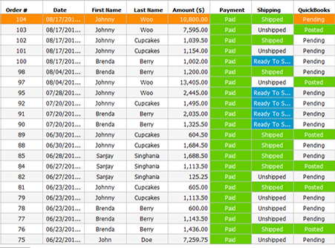
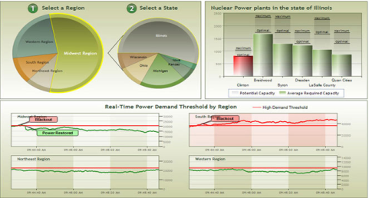



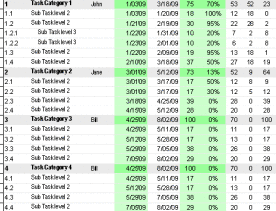
Data Base Management System
Data Warehouse
Grade Database Management
Product Definition Management
History Analysis
Report
Production Planning
Slab Yard
Utility
Production Dashboard
Order Process Dashboard
Process Email Alarm
Indonesian Language Pack
Cloud Implementation
PPIC Automation
Scheduling

Slide 16
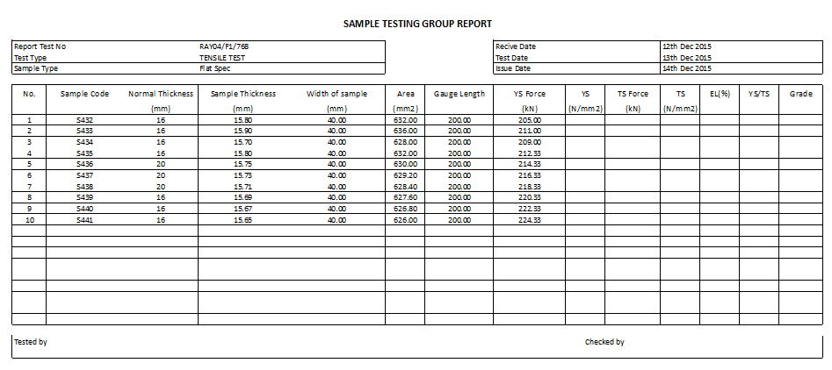
Product Sample Test Report

Slide 17
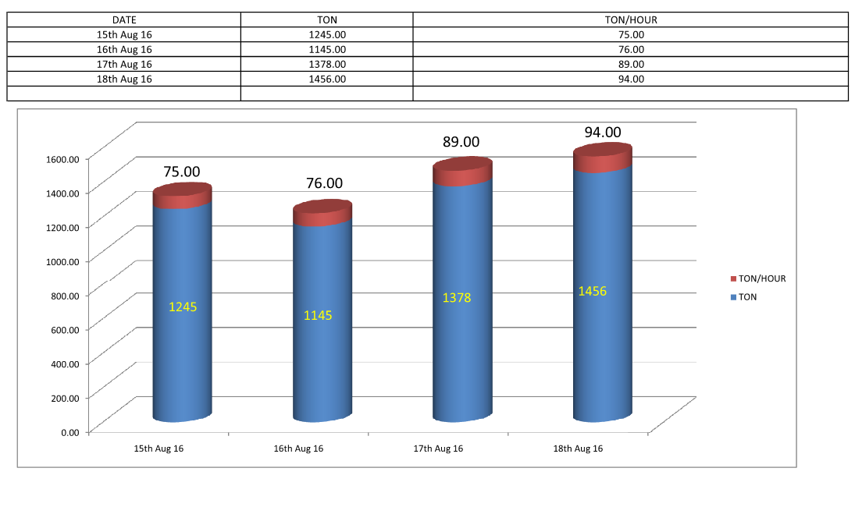
Production Report (Ton / Hr)

Slide 18

Data Base Management System for Slab Yard, Plate and Quality Control with Material Test Certificate (MTC)

Slide 19
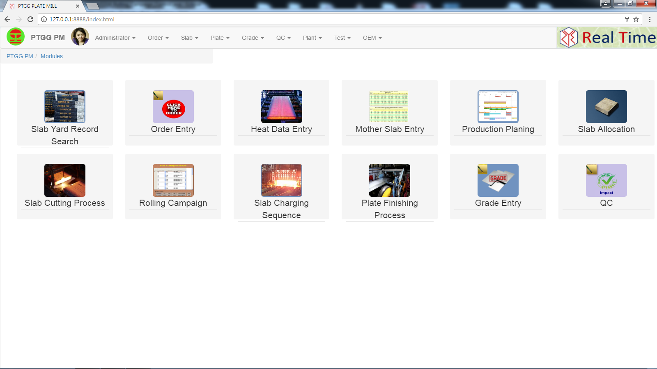
Data Base Management System for Slab Yard, Coil Yard & Plate and Quality Control with Material Test Certificate (MTC)

Slide 20
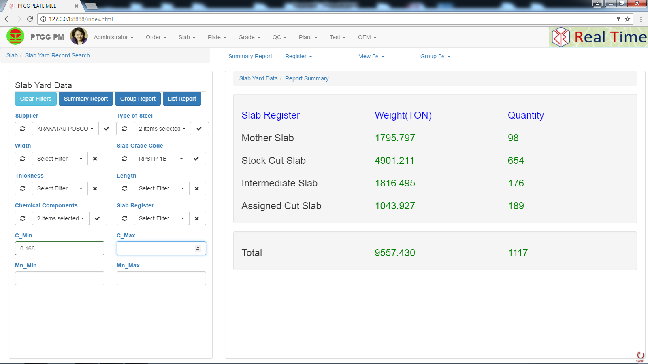
Data Base Management System for Slab Yard, Coil Yard & Plate Stock and Quality Control with Material Test Certificate (MTC)

Slide 21
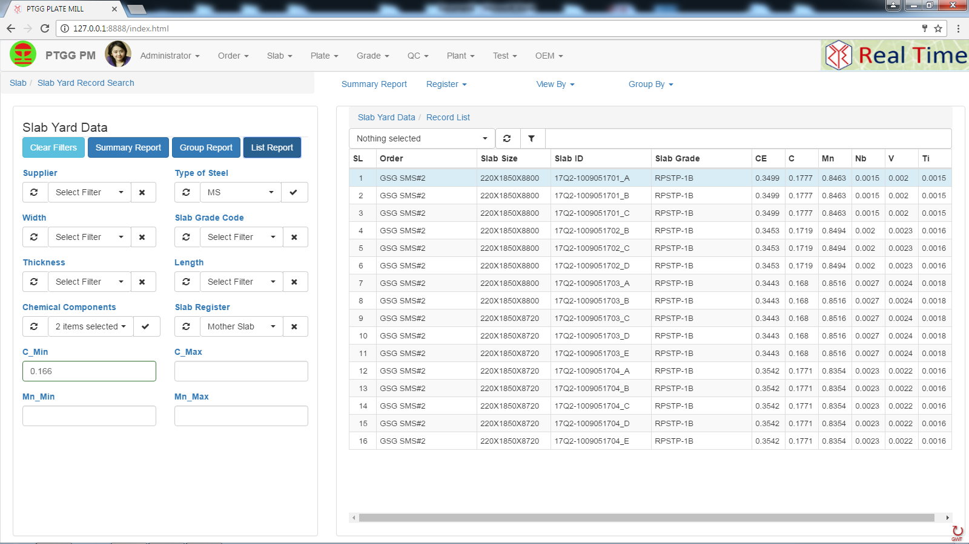
Data Base Management System for Slab Yard, Coil Yard & Plate Stock and Quality Control with Material Test Certificate (MTC)

Slide 22
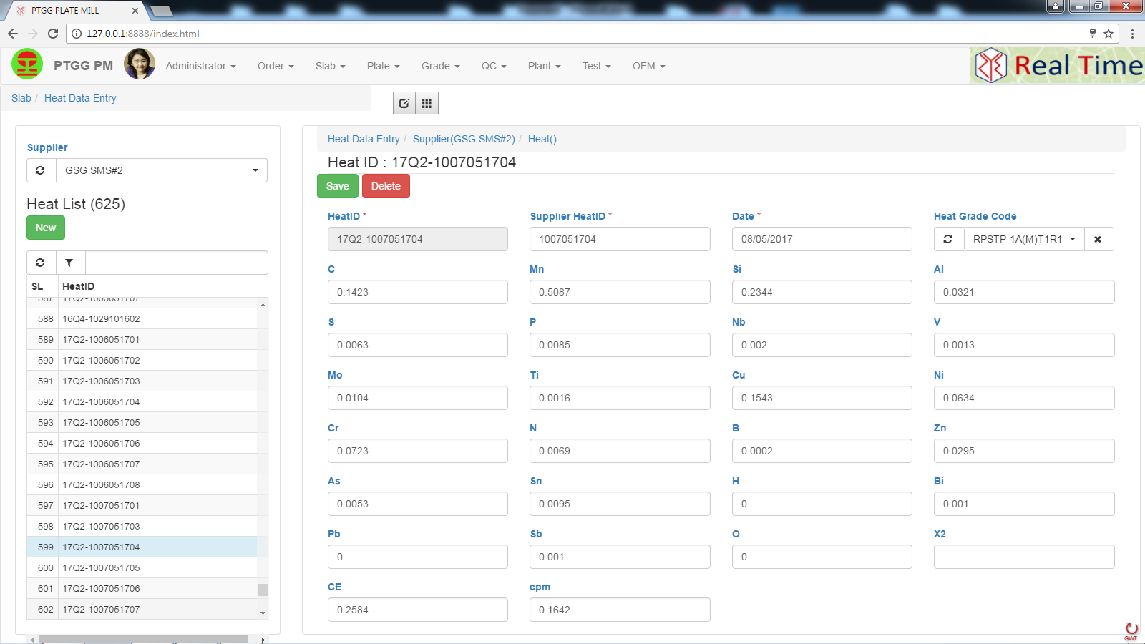
Data Base Management System for Slab Yard, Plate Stock and Quality Control with Material Test Certificate (MTC)

Slide 23
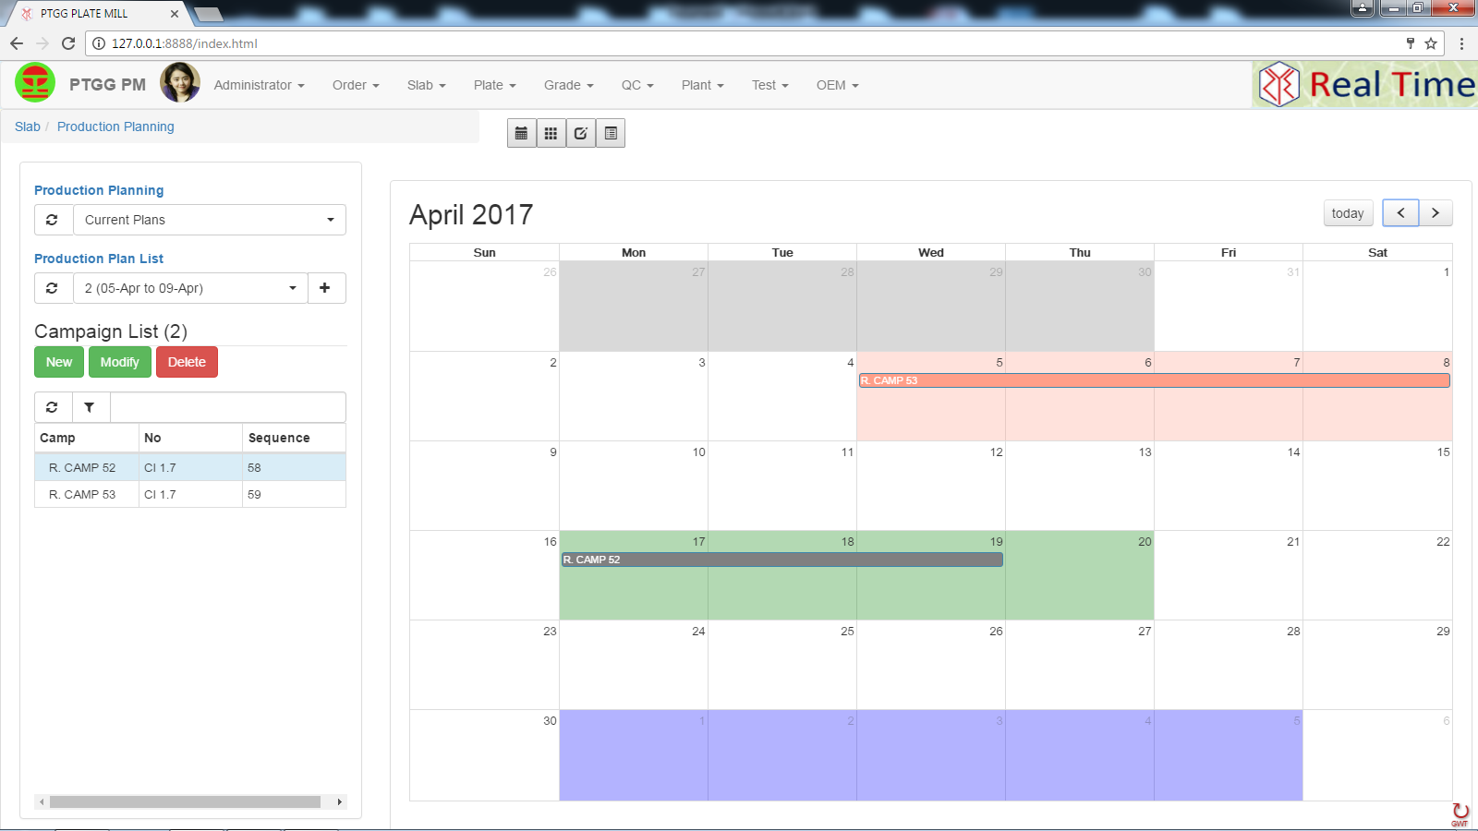
Data Base Management System for Slab Yard, Plate and Quality Control with Material Test Certificate (MTC)

Slide 24
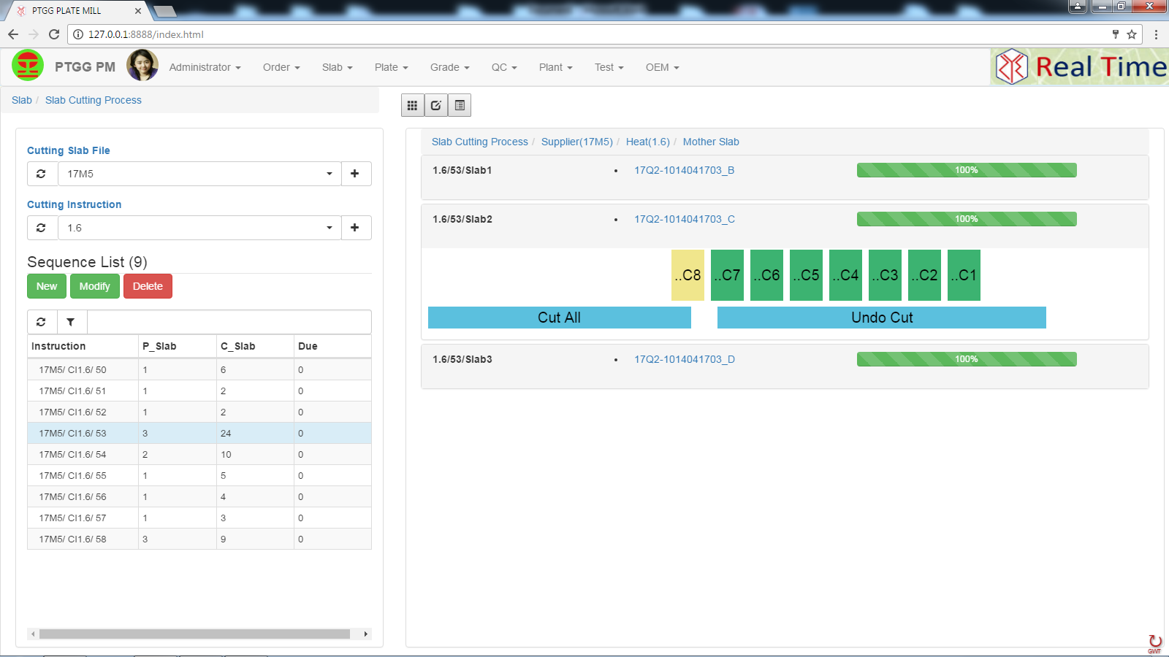
Data Base Management System for Slab Yard, Plate and Quality Control with Material Test Certificate (MTC)

Slide 25
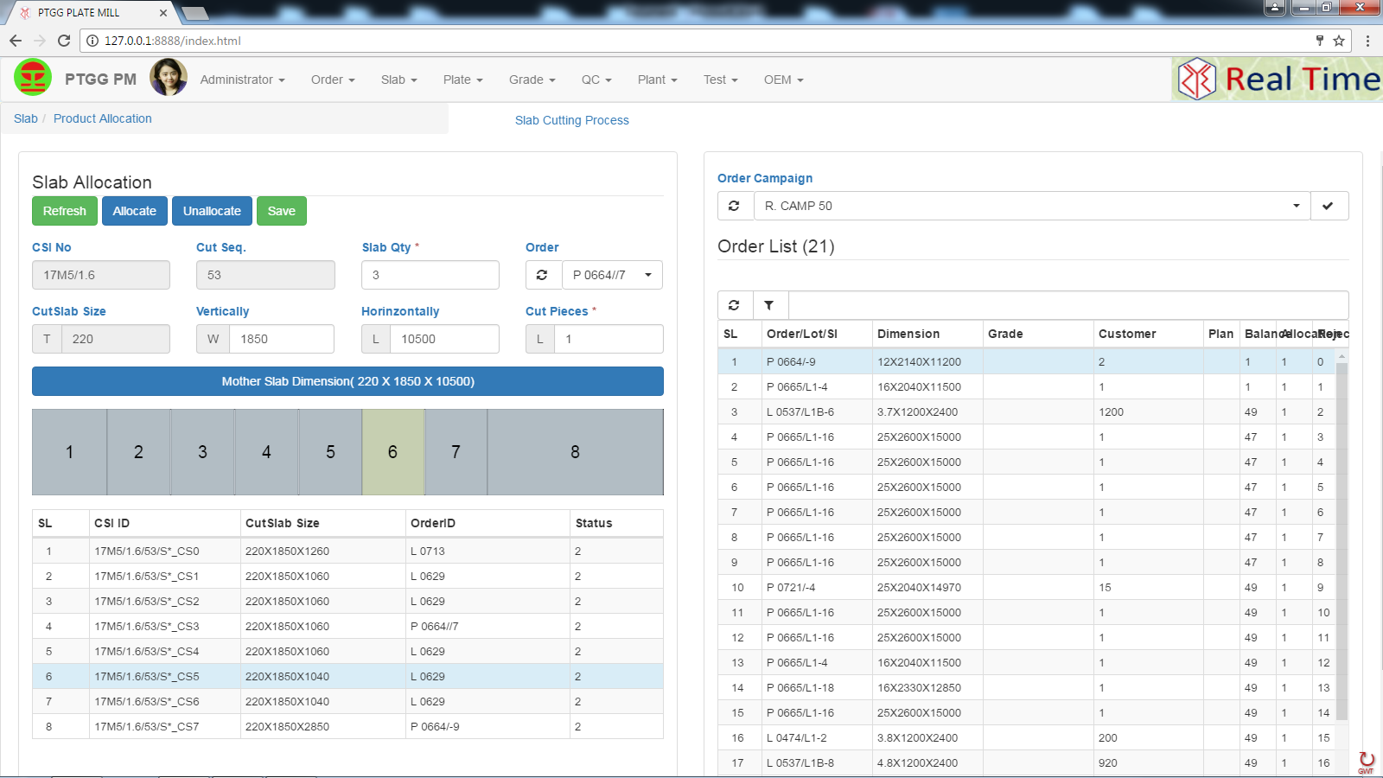
Data Base Management System for Slab Yard, Plate and Quality Control with Material Test Certificate (MTC)

Slide 26
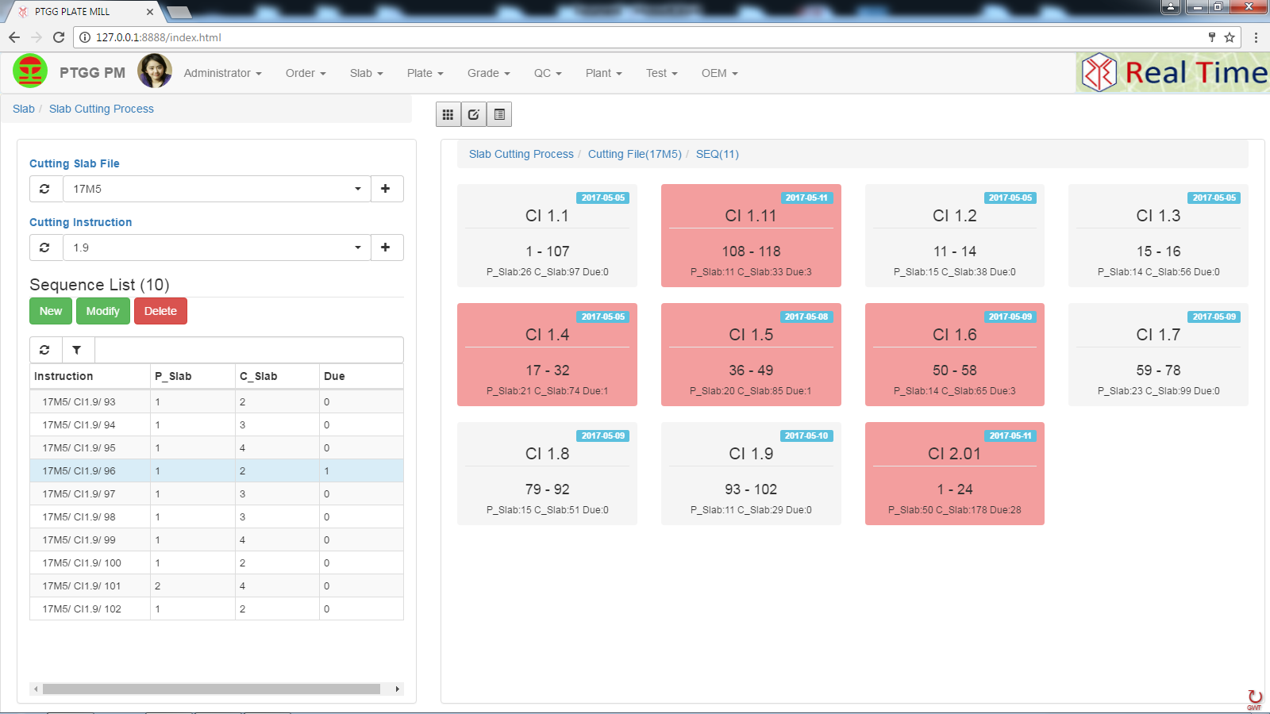
Data Base Management System for Slab Yard, Plate and Quality Control with Material Test Certificate (MTC)

Slide 27
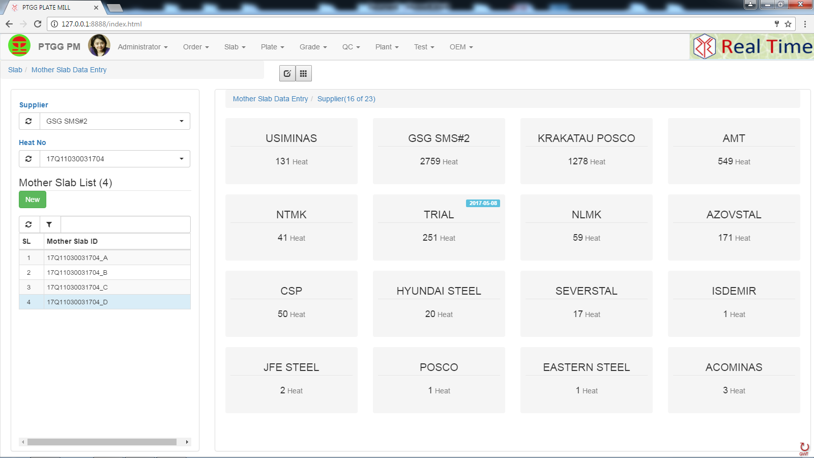
Data Base Management System for Slab Yard, Plate and Quality Control with Material Test Certificate (MTC)

Slide 28
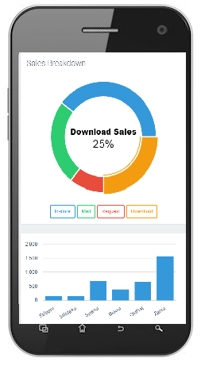
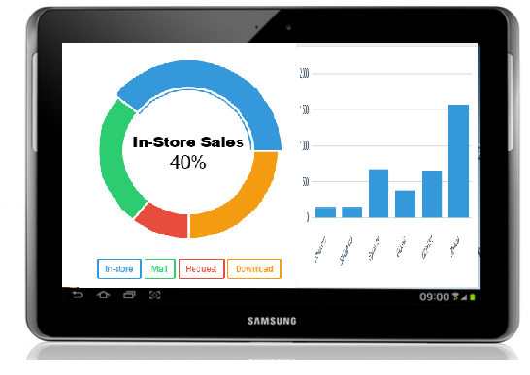
Device Independent Application

Slide 29
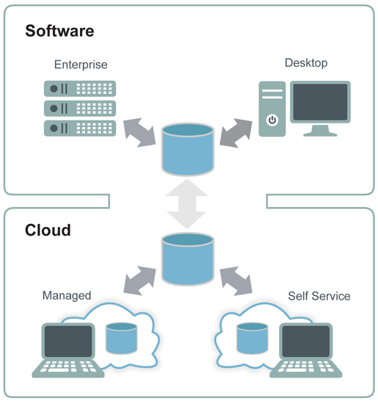


Global Probability

